Slide 1

Business Case/Proposal
Sue Byeon

Slide 2

Executive Summary
Legacy manual task assignment incurs operational costs, reduces service quality, and lowers customer satisfaction in telecom.
But Automated Technical Task Matching System can provide:
1
Automated Matching
Matches best technician to job based on skillset
2
Faster Service
Improves connectivity
3
Happier Customers
Raises satisfaction scores

Slide 3
Industry Context
Focus Industry: | Telecommunications
Population Impacted: | Individuals & Business needing Reliable Internet
Key Challenges: | Inefficient Technician Management Outdated Scheduling System Unmet Service Requests

Slide 4
Problem Statement
Misaligned Technician Assignments
Lost Trust & Dissatisfaction
Advanced Network Technology
Losing $2.09 billion/year from churn*
Customers rely on fast, reliable connections for work, school, and social life.
Great Product, Poor Experience
* For a company with 100,000 customers, 30% annual churn rate, and ARPU of $69,690

Slide 5
Current State Analysis & Metrics
Task request
Dispatcher assigns manually
Relies on availability or location only
Frequent mismatches → failed work orders & costly rework
Task execution
Outcome
Customer dissatisfaction — delays & missed appointments
Technician frustration & burnout
Low morale → high turnover & labor risks
Customer schedules technician service requests
No expertise matching
Technician assigned randomly
58%
Expertise Match Rate
58%
Task Completion Rate
$16.8K
Total Penalty Cost for Delays
3.06
Customer Satisfaction Score

Slide 6
Risks of Inaction
Financial
Escalating rework costs from failed assignments (e.g., truck rolls, technician overtime)
Lost revenue due to missed SLAs and churn from dissatisfied customers
Operational
Continued inefficient scheduling → technician idle time and misallocations
Increased turnover and burnout, driving up recruiting and training costs
Reputational
Decline in customer trust and satisfaction scores
Risk of negative reviews, regulatory scrutiny, or union action due to poor working conditions
Inability to scale → foregone market opportunities and lose industry competitiveness
Stagnant service capacity limits ability to handle growth

Slide 7
Proposal/Technical Solution Overview
Automated Technical Task Matching System
Scalable Infrastructure & Automation: Cloud-based, real-time assignment engine
Improved UI for seamless and intuitive navigation
ML Matching Algorithm: Leverages historical performance, expertise, and task data
Continuous Monitoring: Feedback loop to fine-tune performance
Robust Database & Pipeline to feed algorithm
Faster & Smarter Decisions on Assigning Technicians

Slide 8
Implementation Plan
Business Understanding
Data Understanding
Data Preparation
Evaluation
Modeling
Deployment
Determine objectives & success criteria
Identify & collect data
EDA
Clean, transform, and standardize data
Model selection
Assess results vs objectives
User acceptance testing
Integrate model into current system
Document process
System Training
Assess Situation
Create Project Plan
Develop algorithm
Fine tuning
Test & validate model
Develop continuous Improvement plan
Develop Monitoring and Maintenance Plan
Develop backend & frontend framework
Develop UI

Slide 9
Requirements by team
Administration Team
Human Resources
Technical Resources
Analyst Team
Human Resources
Technical Resources
Backend Development Team
Frontend Development Team
IT Operations
Project managers (PM)
Project Management platform (Excel)
Human Resources
Human Resources
Human Resources
Technical Resources
Technical Resources
Technical Resources
Business stakeholders (BS)
Change managers (CM)
Data analysts (DA)
Data scientists (DS)
Data engineer (DE)
ML engineer (ML Eng)
Backend developer (Back Dev)
API architect (API Arch)
Database developer (DB Dev)
Frontend developer (Front Dev)
UI/UX developer (UI/UX Dev)
DevOps engineer (DevOps)
Cloud architect (Cloud Arch)
Security engineer (Sec Eng)
Documentation tool (SharePoint)
Data: Historical work orders, technician attributes, performance records (Kaggle*)
Data storage (SQL/PostgreSQL)
Visualization tool (PowerBI)
Source code editor (VS Code)
Backend framework (FastAPI)
REST API setup (Postman)
Version control (GitHub)
Frontend framework (React)
UI libraries (Tailwind CSS)
Cloud environment (AWS EC2)
Containerization (Docker)
CI/CD tools (GitHub Actions)
Machine Learning environment (Python & AWS Sagemaker)
* Link to Kaggle Dataset: https://www.kaggle.com/datasets/ziya07/technician-scheduling-dataset

Slide 10

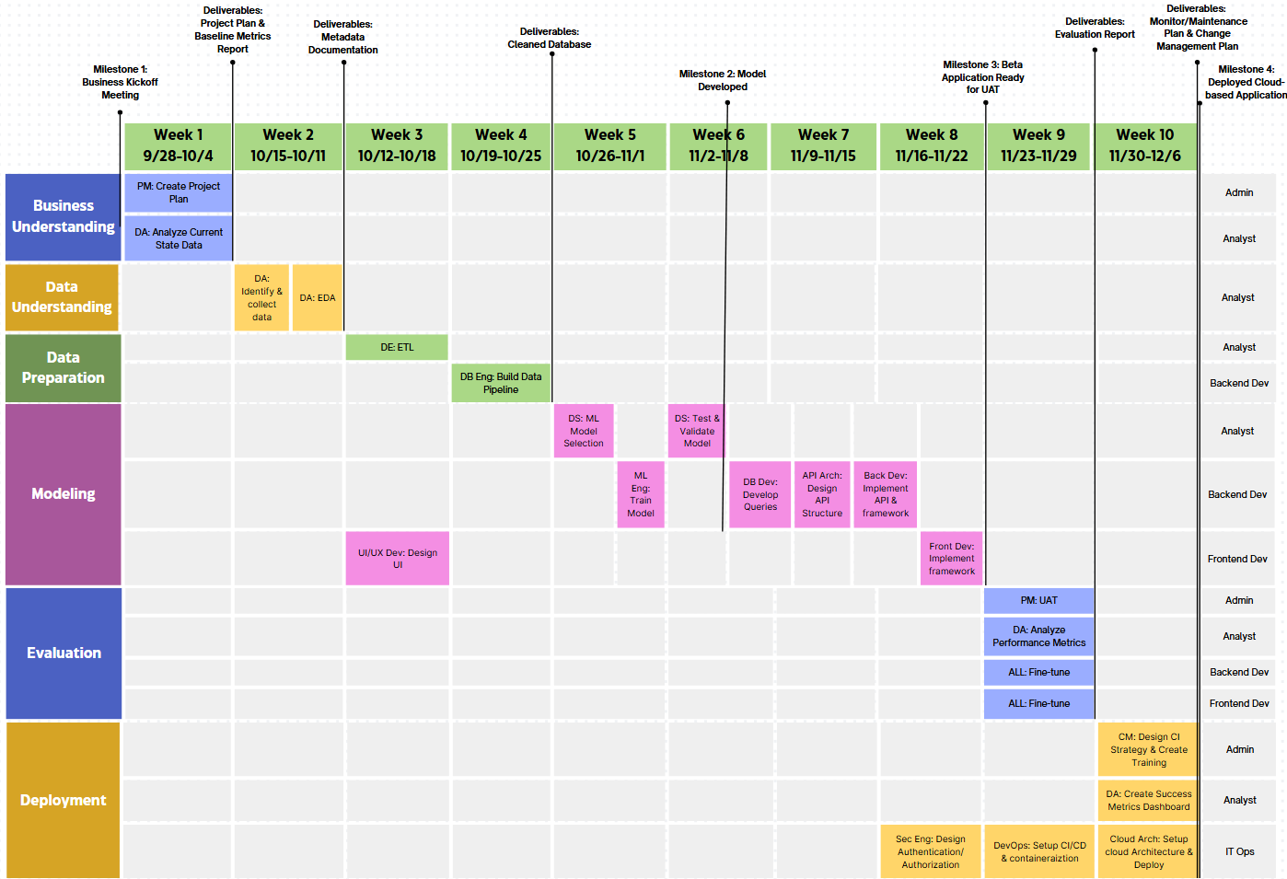

Slide 11
Benefits & Expected Outcomes
Financial
Reduced rework and repeat visits
↓ Operational costs
Operational
Higher task completion rates
↑ Efficiency, faster job turnaround
Strategic
Improved customer satisfaction
Increase technician satisfaction
↑ profit margins
Better technician-job matching
↓ Errors,
↑ first-time fix rate
↑ Retention & referrals
↓ Turnover, stronger workforce

Slide 12
Success metrics
Metrics | Baseline | Target
Expertise Match Rate | 58% | ↑ to 90%
Task Completion Rate | 58% | ↑ to 90%
Total Penalty Cost for Delays | $16.8K | ↓ to $8K
Customer Satisfaction Score (Poor: 1- Great: 5) | 3.06 | ↑ to 5
Milestones & Measurement Plan
Baseline Established — Metrics collected from current system (Week 1)
Pilot Implementation — Run system on limited group, measure impact (Week 8-9)
Full Deployment — Track weekly performance vs. targets (4 weeks after Week 10)
Success Evaluation — Metrics reviewed; success = hitting ≥80% of targets (Week 14)

Slide 13
Risk Management & Mitigation
Risk | Mitigation Strategy
Data quality issues | Establish data validation and cleaning pipelines; use imputation for missing values; run regular bias checks.
Limited specialized technicians | Start with high-impact job matching first; implement targeted training or hiring plans to close skill gaps.
Expensive infrastructure | Begin with a pilot to optimize cloud usage; leverage autoscaling and model optimization to manage costs.
Change management resistance | Engage stakeholders early, provide training, run parallel manual + automated scheduling before full adoption.

